Slide 1
2.3 Stabilizing the static working point Q
稳定放大电路工作点Q
Many factors can affect the static working point Q
1. Aging 老化
2. Fluctuation of supply voltage V_{CC}
3. Temperature effect

Slide 2
Temperature effect
i_{C}
I_{B1}
Q’
I_{BQ}
Q
I_{B2}
0
U_{CEQ}
u_{CE}
Temperature ↑, keep I_{BQ} constant
I_{CQ} ↑
U_{CEQ} ↓
β ↑

Slide 3




2.3.1 Application of negative feedback in stabilizing the static working point Q
负反馈在稳定静态工作点中的应用
Direct coupling
Resistance-capacitance coupling
V_{CC}
V_{CC}
R_{B2}
R_{B2}
R_{C}
R_{C}
C₂
+
C₁
c
+
R_{B1}
c
T
T
b
b
e
+
e
R_{L}
+
R_{B1}
R_{E}
-
R_{E}
C_{E}
-
-
-

Slide 4




V_{CC}
Static/DC circuit
R_{B2}
R_{C}
V_{CC}
C₂
C₁
c
+
R_{B2}
R_{C}
T
+
b
R_{B1}
c
+
e
R_{L}
T
R_{B1}
b
-
R_{E}
C_{E}
+
e
-
-
R_{E}
V_{CC}
-
R_{B2}
R_{C}
c
T
b
e
R_{B1}
R_{E}

Slide 5

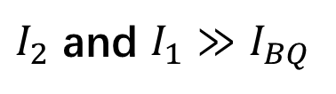

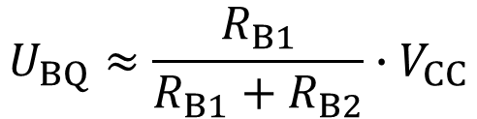
Working principle
V_{CC}
R_{B2}
I₂
R_{C}
I_{CQ}
I_{BQ}
c
To make Q point stable, we let
U_{BQ}
T
b
e
R_{B1}
I₁
U_{EQ}
R_{E}
I_{EQ}
Then U_{BQ} is unrelated to temperature
T ↑
I_{CQ} ↑
I_{EQ} ↑
U_{EQ} ↑
U_{BEQ}= U_{BQ}- U_{EQ}
I_{CQ} ↓
I_{BQ} ↓
U_{BEQ} ↓

Slide 6
V_{CC}
Feedback 反馈
Transport output signal (I_{C}) back to the input circuit, and in turn affect the input signal (U_{BEQ})
R_{B2}
I₂
R_{C}
I_{CQ}
I_{BQ}
c
U_{BQ}
T
b
Negative Feedback 负反馈
e
R_{B1}
I₁
U_{EQ}
The feedback make the variation of output signal smaller
R_{E}
I_{EQ}
DC Negative Feedback 直流负反馈
T ↑
I_{CQ} ↑
I_{EQ} ↑
U_{EQ} ↑
U_{BEQ}= U_{BQ}- U_{EQ}
I_{CQ} ↓
I_{BQ} ↓
U_{BEQ} ↓

Slide 7


[Q1] As shown in the figure，R_{B2}=39kΩ，R_{B1}=10kΩ，R_{C}=2.7kΩ，R_{E}=1kΩ，R_{L}=5.1kΩ，C₁=C₂=10μF，C_{e}=47μF，V_{CC}=15V，transistor has β =100、r_{bb'}=300Ω、U_{BEQ}=0.7V ：
(1) Parameters of static working point Q
V_{CC}
(2) Parameters of dynamic working point A_{u}，R _{i}，R_{o}
R_{B2}
R_{C}
C₂
C₁
c
+
T
b
+
e
R_{L}
R_{B1}
-
R_{E}
C_{E}
-

Slide 8

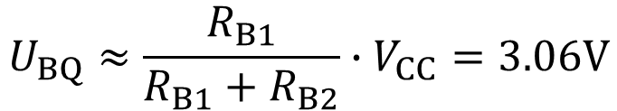
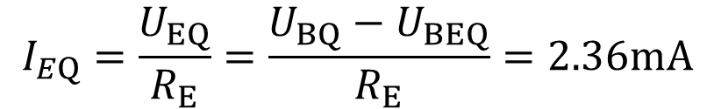
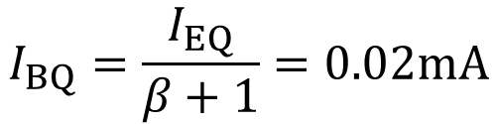
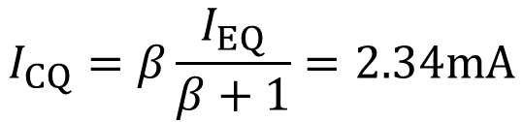
[Q1] As shown in the figure，R_{B2}=39kΩ，R_{B1}=10kΩ，R_{C}=2.7kΩ，R_{E}=1kΩ，R_{L}=5.1kΩ，C₁=C₂=10μF，C_{e}=47μF，V_{CC}=15V，transistor has β =100、r_{bb'}=300Ω、U_{BEQ}=0.7V ：
(1) Parameters of static working point Q
V_{CC}
R_{B2}
I₂
R_{C}
I_{CQ}
c
U_{BQ}
T
b
e
R_{B1}
I₁
U_{EQ}
R_{E}
I_{EQ}

Slide 9
Another approach:
Thevenin's theorem
戴维南定理
V_{CC}
V_{CC}
V_{CC}
V_{CC}
V_{CC}
R_{B2}
I₂
R_{C}
I_{CQ}
R_{B2}
I₂
R_{C}
I_{CQ}
R_{B2}
I₂
R_{C}
I_{CQ}
c
c
c
U_{BQ}
T
U_{BQ}
T
U_{BQ}
T
b
b
b
e
e
e
R_{B1}
I₁
U_{EQ}
U_{EQ}
U_{EQ}
R_{B1}
I₁
R_{B1}
I₁
R_{E}
I_{EQ}
R_{E}
I_{EQ}
R_{E}
I_{EQ}

Slide 10
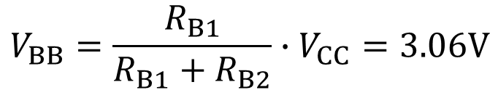

Another approach:
Thevenin's theorem
戴维南定理
V_{CC}
V_{CC}
V_{BB}
V_{CC}
V_{CC}
R_{C}
I_{CQ}
R_{B}
R_{C}
I_{CQ}
R_{B2}
I₂
R_{C}
I_{CQ}
I_{BQ}
c
c
c
I_{BQ}
T
T
U_{BQ}
T
b
b
b
e
e
e
R_{B}
R_{B1}
I₁
U_{EQ}
R_{E}
I_{EQ}
R_{E}
I_{EQ}
R_{E}
I_{EQ}
V_{BB}

Slide 11
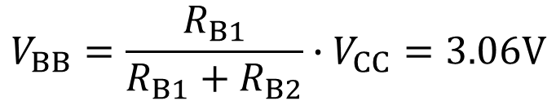



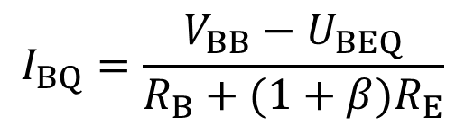
V_{CC}
R_{C}
I_{CQ}
I_{BQ}
c
T
b
e
R_{B}
R_{E}
I_{EQ}
V_{BB}

Slide 12




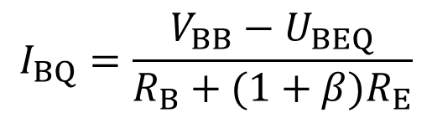
The 3rd approach:
暴力求解法
V_{CC}
R_{B2}
I₂
R_{C}
I_{CQ}
I_{BQ}
c
U_{BQ}
T
b
e
R_{B1}
I₁
U_{EQ}
R_{E}
I_{EQ}

Slide 13






(2) A_{u}，R _{i}，R_{o}
R_{B2}
R_{C}
V_{CC}
c
+
R_{B2}
R_{C}
C₂
T
C₁
+
b
c
+
e
R_{L}
T
R_{B1}
b
-
R_{E}
+
e
R_{L}
R_{B1}
-
-
R_{E}
C_{E}
-
1st step: get AC circuit.
c
+
T
b
+
e
R_{C}
R_{L}
R_{B2}
R_{B1}
-
-

Slide 14












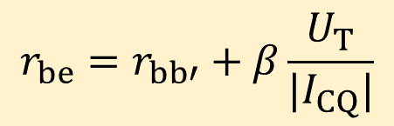






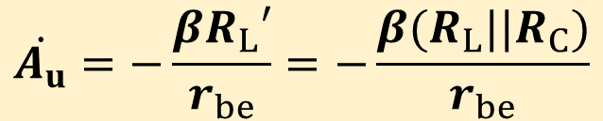


c
+
T
b
+
+
+
e
R_{C}
R_{L}
R_{B2}
R_{B1}
-
-
-
-
2nd step: get h-model.
+
+
R_{B}
R_{C}
R_{L}
-
-

Slide 15


[Q2] Same parameter as Q1: R_{B2}=39kΩ，R_{B1}=10kΩ，R_{C}=2.7kΩ，R_{E}=1kΩ，R_{L}=5.1kΩ，C₁=C₂=10μF，C_{e}=47μF，V_{CC}=15V，transistor has β =100、r_{bb'}=300Ω、U_{BEQ}=0.7V ：
(1) Parameters of static working point Q
(2) Parameters of dynamic working point A_{u}, R _{I}, R_{o}
V_{CC}
R_{B2}
R_{C}
C₂
C₁
c
+
Ans: (1) The DC circuit in Question 2 is the same as Question 1. So the static working point is the same.
T
b
+
e
R_{L}
R_{B1}
-
R_{E}
-

Slide 16

(2) Answer:
R_{B2}
R_{C}
V_{CC}
c
+
R_{B2}
R_{C}
C₂
T
C₁
+
b
c
+
e
R_{L}
T
R_{B1}
b
-
R_{E}
+
e
R_{L}
R_{B1}
-
-
R_{E}
C_{E}
-
c
+
T
b
+
e
R_{C}
R_{L}
R_{B2}
R_{B1}
-
R_{E}
-

Slide 17















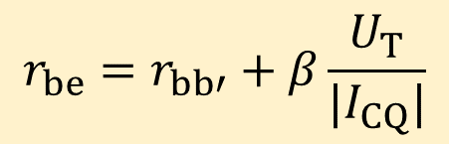


c
+
T
b
+
+
+
e
R_{C}
R_{L}
R_{B2}
R_{B1}
-
R_{E}
-
-
-
+
+
R_{B}
R_{C}
R_{L}
-
R_{E}
-

Slide 18










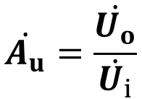
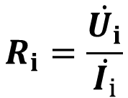




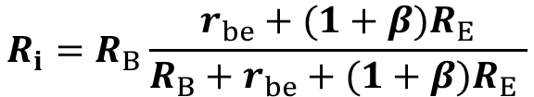
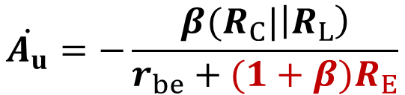


+
+
R_{B}
R_{C}
R_{L}
-
R_{E}
-
Voltage gain:
Input resistance:

Slide 19







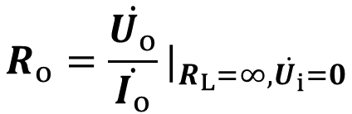









+
+
R_{B}
R_{C}
R_{L}
Output resistance:
-
R_{E}
-
Because the current source has an infinite resistance
+
R_{B}
R_{C}
R_{E}
-

Slide 20
Summary
Common-emitter amplifier
a) Can amplify the voltage signal
b) There is 180º phase difference between u_{o} and u_{i}
c) Can amplify the current and power
具有电流放大能力和功率放大能力。
d) Low input resistance and high output resistance (compared with common-collector and common-base amplifier).具有低的输入电阻和高的输出电阻(相比于其它接法：共集和共基)。

Slide 21




2.4 Common-collector amplifier
共集极放大电路
The output voltage is from emitter (发射极), is also called emitter follower (射极输出器)
V_{CC}
V_{CC}
R_{B2}
R_{B2}
R_{B1}
c
C₁
c
T
C₂
T
C₂
b
b
e
e
+
+
+
+
R_{B1}
-
R_{E}
-
R_{E}
R_{L}
-
-
Q: Why is called common-collector?

Slide 22


Static analysis 静态分析
DC circuit
V_{CC}
V_{CC}
R_{B2}
I_{CQ}
I₂
R_{B2}
C₁
c
c
T
C₂
U_{BQ}
T
b
I_{BQ}
b
e
e
+
+
U_{EQ}
R_{B1}
I₁
R_{B1}
-
R_{E}
R_{L}
R_{E}
I_{EQ}
-

Slide 23

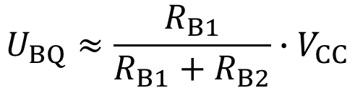
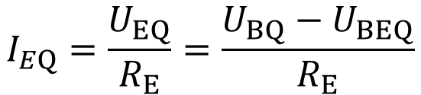
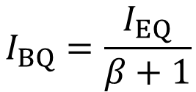
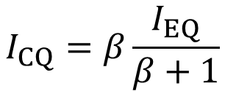

Approximation method估算法
DC circuit
V_{CC}
I_{CQ}
I₂
R_{B2}
c
U_{BQ}
T
I_{BQ}
b
e
U_{EQ}
I₁
R_{B1}
R_{E}
I_{EQ}

Slide 24
Another approach:
Thevenin's theorem
戴维南定理
V_{CC}
V_{CC}
V_{CC}
V_{CC}
V_{CC}
R_{B2}
I₂
I_{CQ}
R_{B2}
I₂
I_{CQ}
R_{B2}
I₂
I_{CQ}
c
c
c
U_{BQ}
T
U_{BQ}
T
U_{BQ}
T
b
b
b
e
e
e
R_{B1}
I₁
U_{EQ}
U_{EQ}
U_{EQ}
R_{B1}
I₁
R_{B1}
I₁
R_{E}
I_{EQ}
R_{E}
I_{EQ}
R_{E}
I_{EQ}

Slide 25
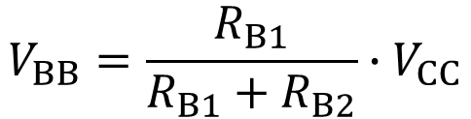

Another approach:
Thevenin's theorem
戴维南定理
V_{CC}
V_{CC}
V_{CC}
I_{CQ}
R_{B2}
I₂
I_{CQ}
I_{BQ}
c
c
T
U_{BQ}
T
b
b
e
e
R_{B}
R_{B1}
I₁
U_{EQ}
R_{E}
I_{EQ}
R_{E}
I_{EQ}
V_{BB}

Slide 26
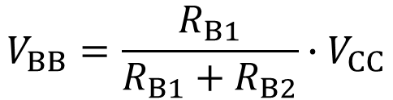

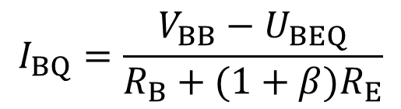
V_{CC}
I_{CQ}
I_{BQ}
c
T
b
e
R_{B}
R_{E}
I_{EQ}
V_{BB}

Slide 27




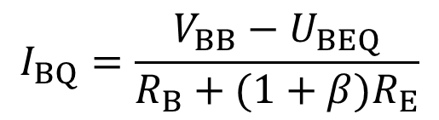
The 3rd approach:
暴力求解法
V_{CC}
R_{B2}
I₂
I_{CQ}
c
U_{BQ}
T
b
e
R_{B1}
I₁
U_{EQ}
R_{E}
I_{EQ}

Slide 28




Dynamic analysis 动态分析
AC circuit
V_{CC}
R_{B2}
C₁
c
c
T
C₂
T
b
b
e
e
+
+
+
+
R_{B1}
R_{B1}
R_{B2}
-
R_{E}
R_{L}
-
R_{E}
R_{L}
-
-

Slide 29



Common-collector!
c
T
-
b
e
R_{B}
+
+
c
+
R_{E}
R_{L}
R_{B1}
R_{B2}
T
-
R_{E}
R_{L}
b
e
-

Slide 30












-
b
c
R_{B}
+
+
+
c
R_{E}
R_{L}
b
T
e
-
e
-
h-model
b
e
+
+
R_{B}
R_{E}
R_{L}
-
c
-

Slide 31
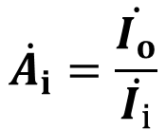


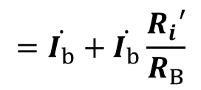

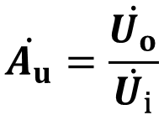
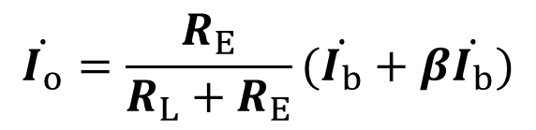

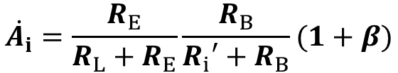

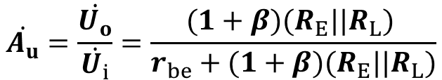




b
e
Current gain:
+
+
R_{B}
R_{E}
R_{L}
-
c
-
Voltage gain:
R_{E} and R_{L} at same order
R_{B} and R_{i}’ at same order
Can not amplify voltage signal!
Can amplify current!
Can amplify power!

Slide 32











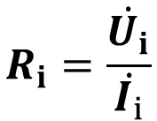


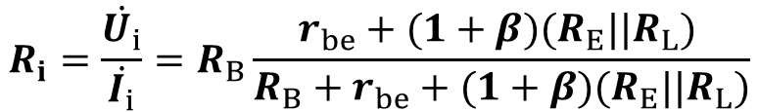

+
+
-
-
Input resistance:

Slide 33












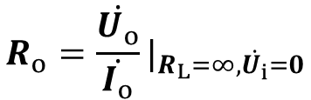


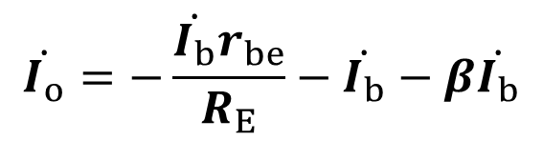
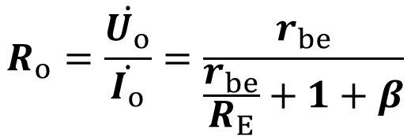
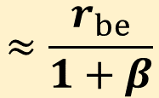
+
+
+
R_{B}
R_{E}
R_{B}
R_{E}
-
-
-
Output resistance:
Output resistance is very small

Slide 34
Summary
Common-collector amplifier
b) The phase of u_{o} and u_{i} are the same
c) Can amplify the current and power
具有电流放大能力和功率放大能力。
d) High input resistance and low output resistance

Slide 35
Application of Common-collector amplifier
a) Impedance transformation 阻抗变换
Used between high internal resistance source and low resistance load.
b) Input and output stage of multistage amplifier circuit

Slide 36












2.5 Common-base amplifier
共基极放大电路
RC coupling
Direct coupling
C₁
R_{E}
R_{E}
C₂
e
e
R_{C}
T
T
b
b
R_{L}
R_{C}
R_{L}
R_{B1}
c
c
R_{B2}
V_{BB}
C₃
V_{CC}
V_{CC}

Slide 37






C₁
Static analysis
DC circuit
R_{E}
C₂
R_{E}
e
e
R_{C}
R_{C}
T
b
R_{L}
R_{B1}
b
R_{B2}
c
R_{B1}
R_{B2}
c
C₃
V_{CC}
V_{CC}
V_{CC}
R_{C}
I_{CQ}
R_{E}
I₂
R_{B2}
R_{B1}
c
e
R_{C}
U_{BQ}
T
I_{BQ}
b
b
e
U_{EQ}
R_{B2}
c
I₁
R_{B1}
R_{E}
I_{EQ}
V_{CC}

Slide 38








C₁
Dynamic analysis
AC circuit
R_{E}
C₂
R_{E}
e
e
R_{C}
R_{C}
T
T
b
b
R_{L}
R_{B1}
R_{L}
R_{B2}
c
R_{B2}
c
C₃
V_{CC}
R_{E}
e
T
R_{L}
R_{C}
b
c

Slide 39






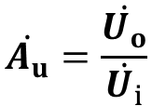










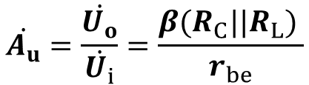

R_{E}
b
c
e
+
+
T
R_{L}
R_{C}
b
c
-
-
e
Voltage gain:
e
c
R_{E}
R_{C}
R_{L}
b
Can amplify voltage

Slide 40














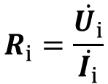

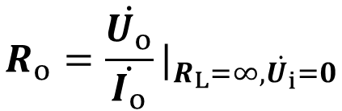

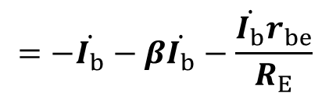

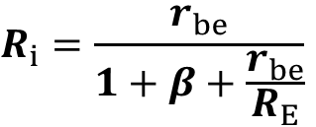
R_{E}
R_{E}
R_{C}
R_{L}
R_{C}
Input resistance:
Output resistance:
Same as common-emitter
Small input resistance

Slide 41






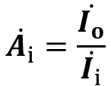



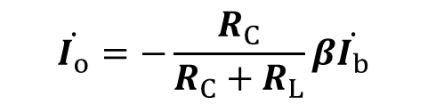
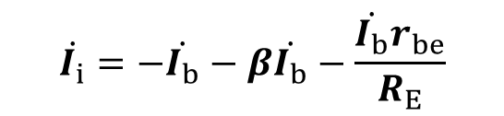
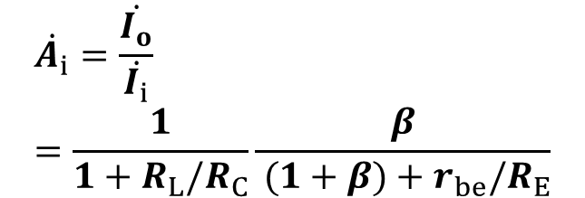

R_{E}
Current gain:
R_{C}
R_{L}
Cannot amplify current

Slide 42
Summary
Common-base amplifier
b) The phase of u_{o} and u_{i} are the same
c) Cannot amplify the current
d) Low input resistance and high output resistance

Slide 43
Compare of common -e, -c and -b amplifier
 | Common-e | Common-c | Common-b
 | High | <1 | High
 | Medium | High | Low
 | High | Low | High
Bandwidth | Narrow | Medium | Wide
No load resistor
Low frequency amplification circuit
High frequency amplification circuit

Slide 44
Homework 2-2:
2.7, 2.9, 2.10, 2.11

Slide 45
2.6 Composite amplifier 复合管
Connect multiple amplifiers together to improve the voltage gain
c
c
NPN-NPN
PNP-PNP
i_{C}= i_{C1}+ i_{C2}
i_{E2}
b
T₁
b
T₁
i_{B1}
i_{B1}
T₂
T₂
i_{E1}(i_{B2})
i_{E2}
i_{E1}(i_{B2})
e
e

Slide 46





e
e
PNP-NPN
NPN-PNP
i_{E}= i_{E1}+ i_{C2}
i_{C2}
b
T₁
b
T₁
i_{B1}
i_{B1}
T₂
T₂
i_{C1}(i_{B2})
i_{C1}(i_{B2})
i_{E}= i_{E1}+ i_{C2}
i_{C}
c
c
The type of composite transistor is determined by T₁
Use PNP-NPN as an example:

Slide 47




c
e
NPN-NPN
i_{C}= i_{C1}+ i_{C2}
i_{C2}
b
T₁
b
T₁
i_{B1}
i_{B1}
T₂
T₂
i_{E1}(i_{B2})
i_{C1}(i_{B2})
i_{E}= i_{E1}+ i_{E2}
i_{E2}
e
c
Q1: Can the configuration of right figure amplify the signal?

Slide 48
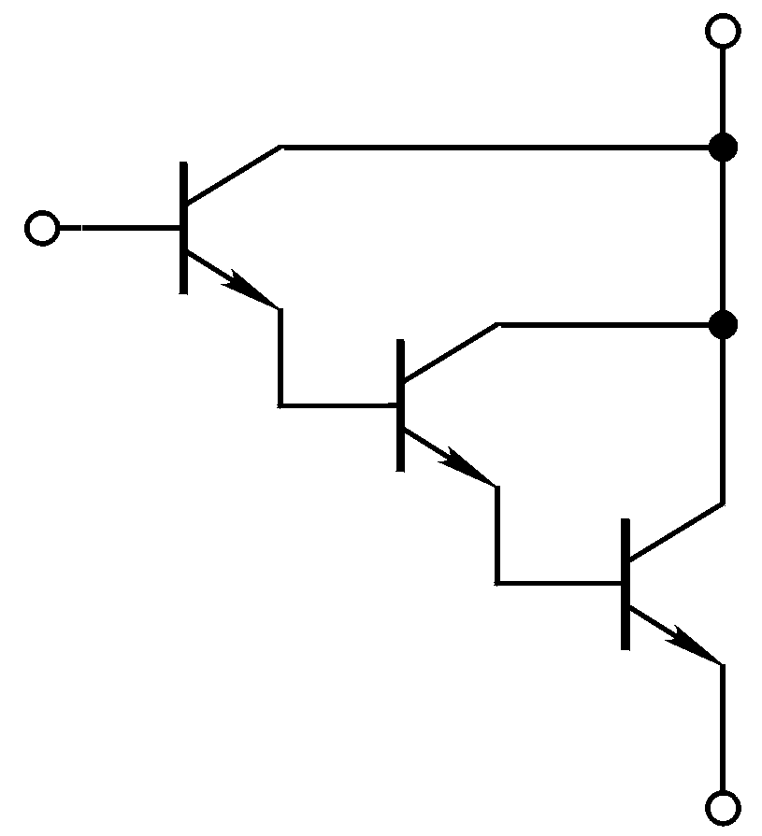
Base principle to build a composite transistor
1. Each transistor need to work in the amplification region
2. Connect the emitter/collector of T1 to the base of T2, connect the emitter/collector of T2 to the base of T3 …

Slide 49


2.6.2 Composite amplifier circuit
Common-collector composite amplifier circuit
Static/DC circuit
V_{CC}
V_{CC}
I_{BQ}
R_{B}
I_{CQ}
R_{B}
C₁
c
T₁
T₁
b
T₂
C₂
T₂
+
+
e
-
R_{E}
R_{E}
R_{L}
-

Slide 50
Static analysis
V_{CC}
U_{BEQ}= U_{BEQ1}+ U_{BEQ2}
I_{BQ}
R_{B}
I_{CQ}
c
V_{CC}= I_{BQ} R_{B} + U_{BEQ}+(I_{BQ}+ I_{CQ}) R_{E}
T₁
b
I_{CQ} = I_{CQ1}+ I_{CQ2}=β₁I_{BQ}+ β₂I_{BQ2}
T₂
e
I_{BQ2} = I_{E1}=(1+β₁)I_{BQ}
R_{E}
I_{EQ}
I_{CQ} = I_{CQ1}+ I_{CQ2}=β₁I_{BQ}+ β₂(1+β₁)I_{BQ}

Slide 51














V_{CC}
Dynamic analysis
c
R_{B}
c
T₁
C₁
b
T₂
b
T₁
+
R_{B}
e
+
T₂
C₂
-
+
e
R_{E}
R_{L}
+
-
-
R_{E}
R_{L}
-
b
c
T₁
T₁
T₂
+
e
T₂
+
R_{B}
+
R_{B}
+
-
-
R_{E}
R_{L}
R_{E}
R_{L}
-
-

Slide 52














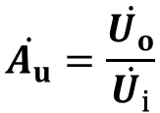















T₁
+
T₂
+
R_{B}
+
R_{B}
+
-
-
R_{E}
R_{L}
R_{E}
R_{L}
-
-
Voltage gain:
+
+
R_{B}
R_{E}
R_{L}
-
-

Slide 53

















Input resistance:
+
+
R_{B}
R_{E}
R_{L}
-
-

Slide 54









Output resistance:
+
R_{B}
R_{E}
-

